Slide 1
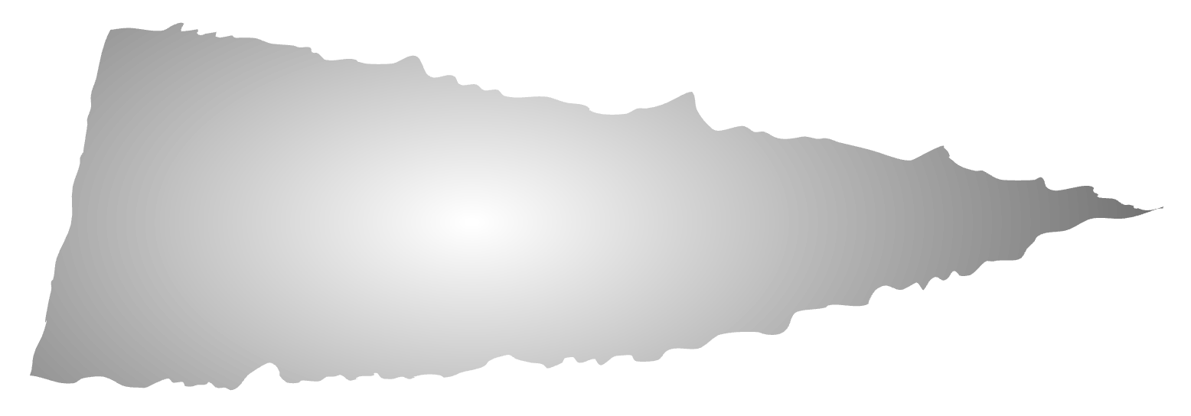
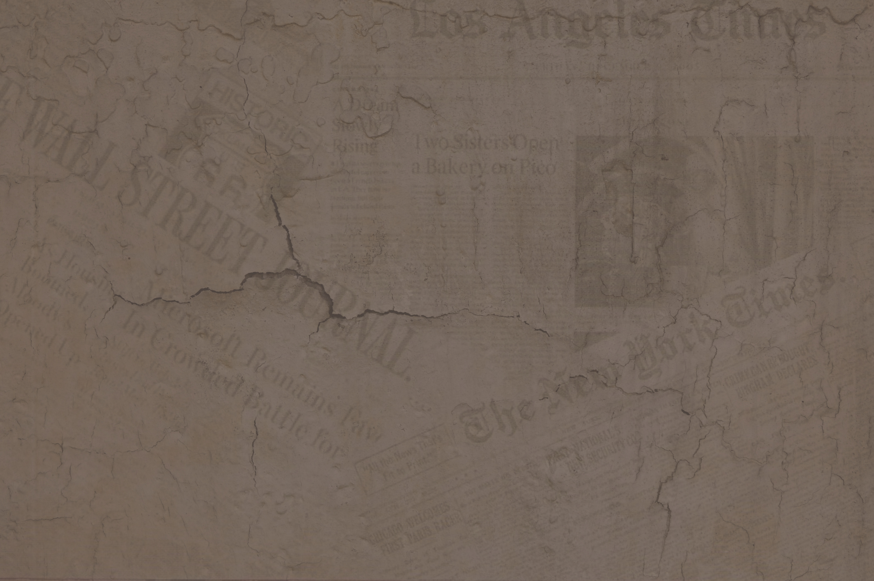
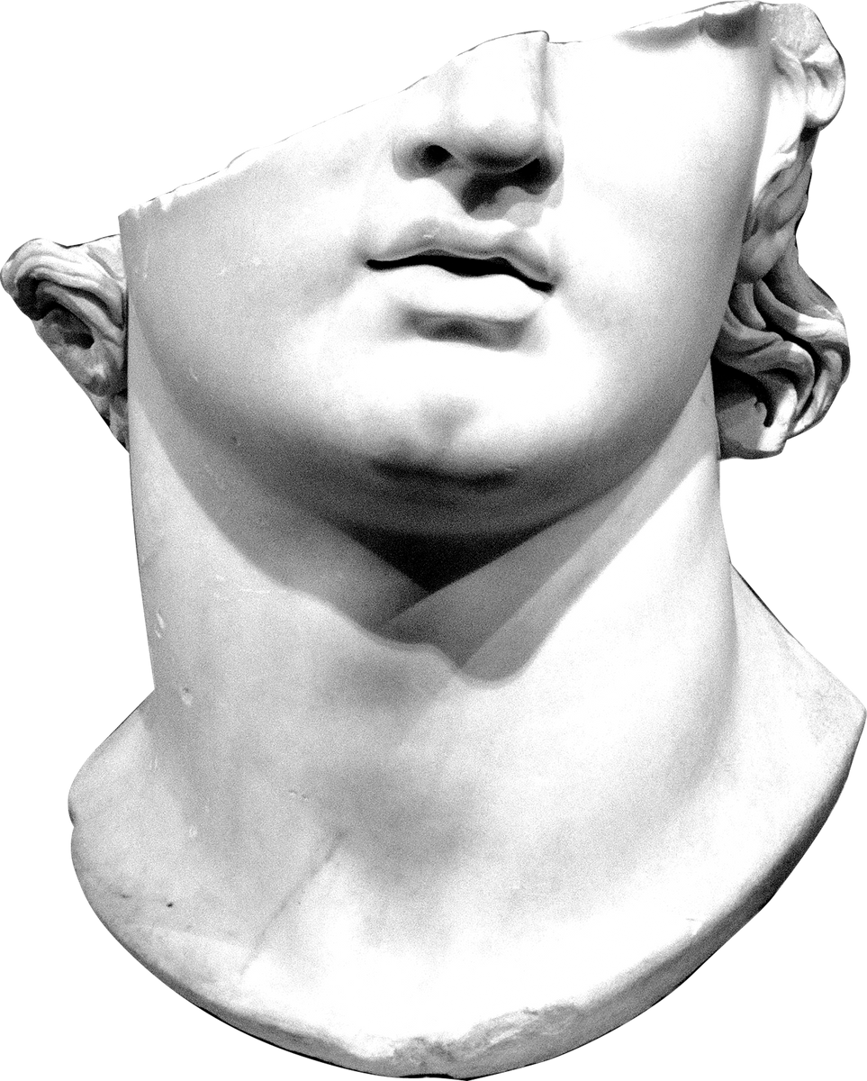
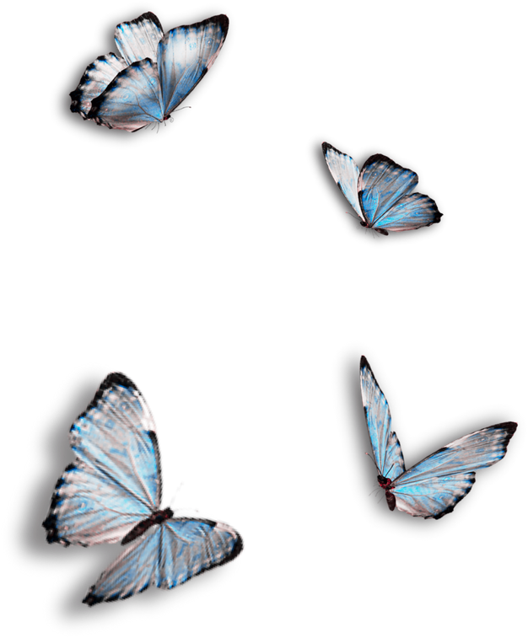
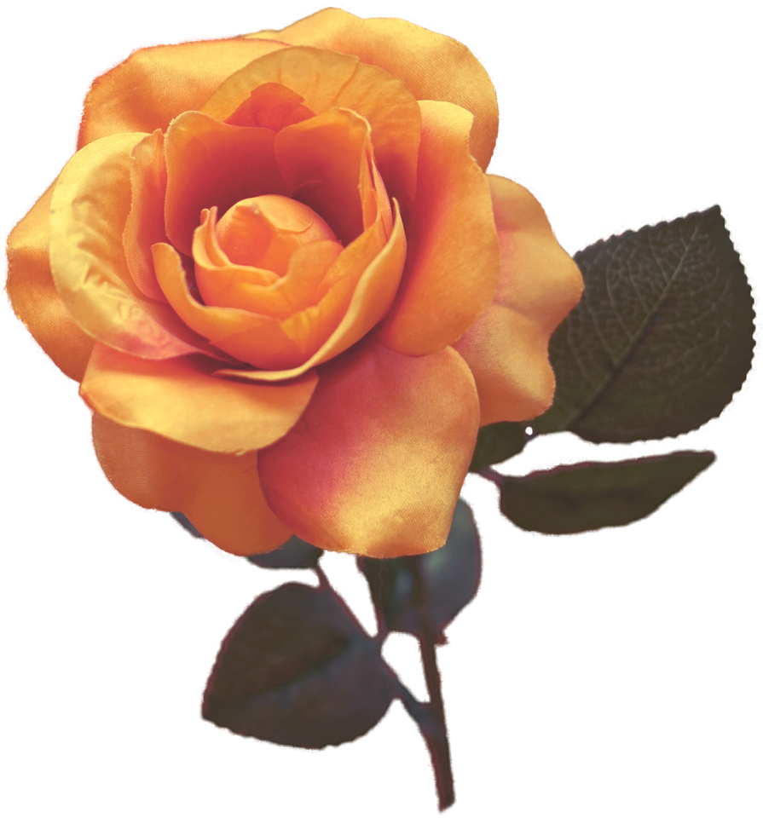
Manus et Machina
THUNDER IN THE SKIES
Presented by Rashed Alshamsi

Slide 2
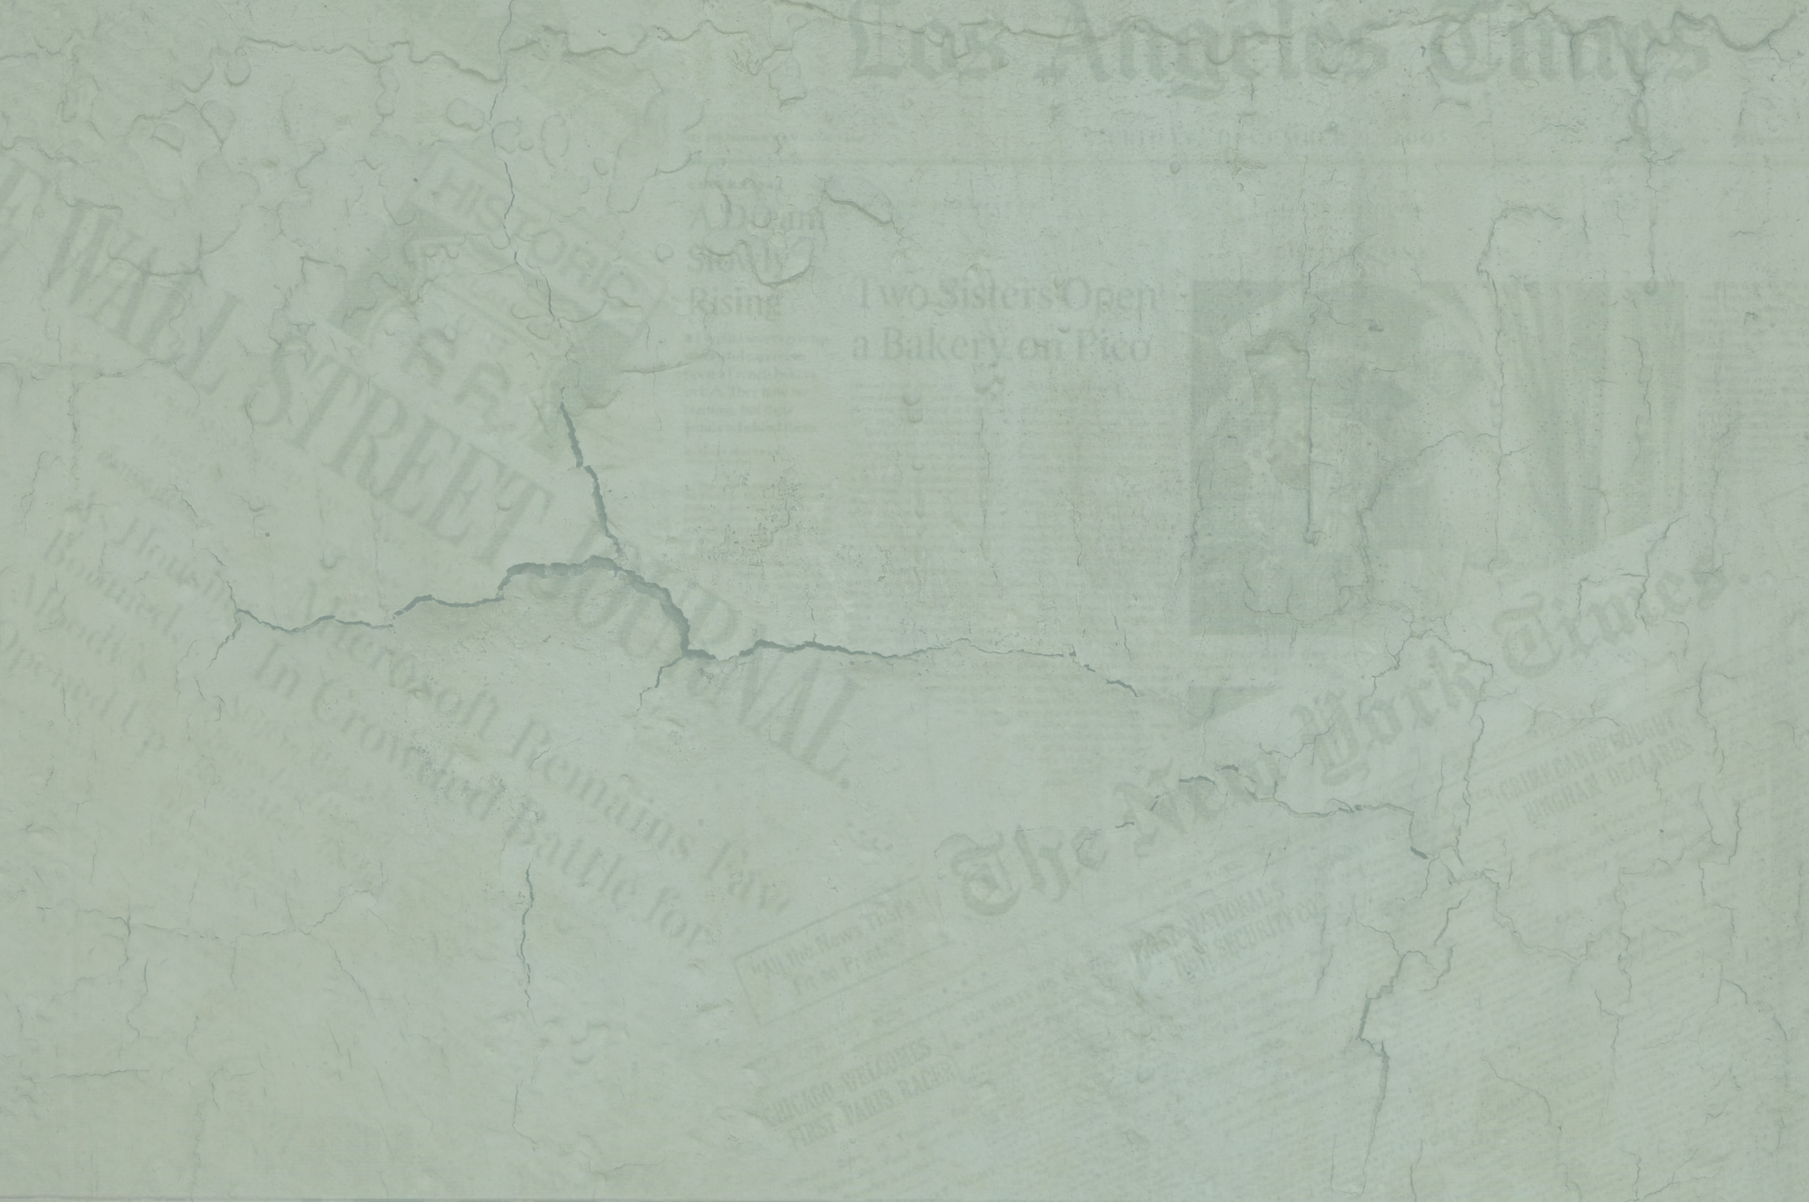
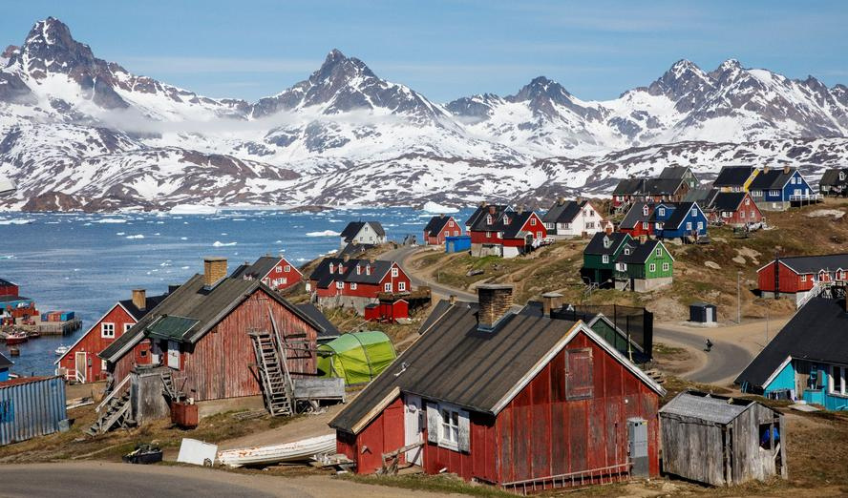
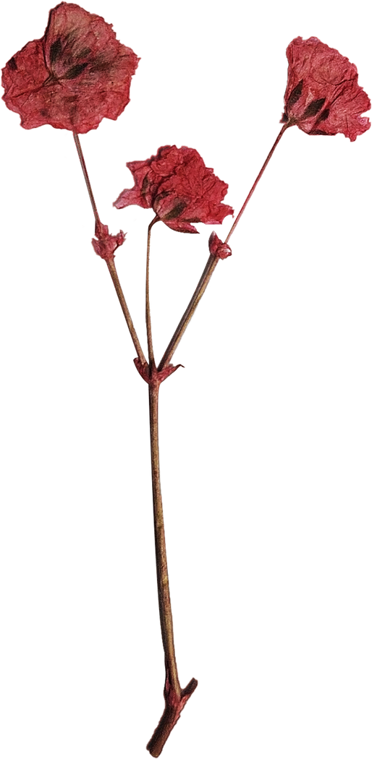
Greenland
Notes:
Seems to be a connection between sunspots and weather; less spots, less heat. Volcanic eruptions spew out dust and screen out the sun’s heat. This eventually cause Greenland to turn white as in, with snow.

Slide 3
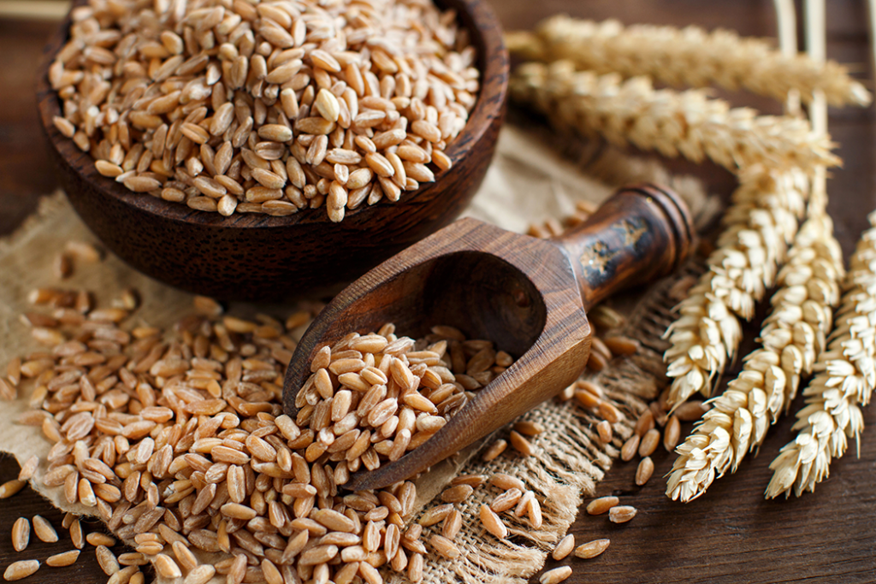
Wheat
Notes:
It was cold and wheat was either too wet or you you had to pellet it In rain and without an adequate drying system, it got moldy.
It was also too cold to grow vines in north France . Kicked off the mideveal ice age

Slide 4

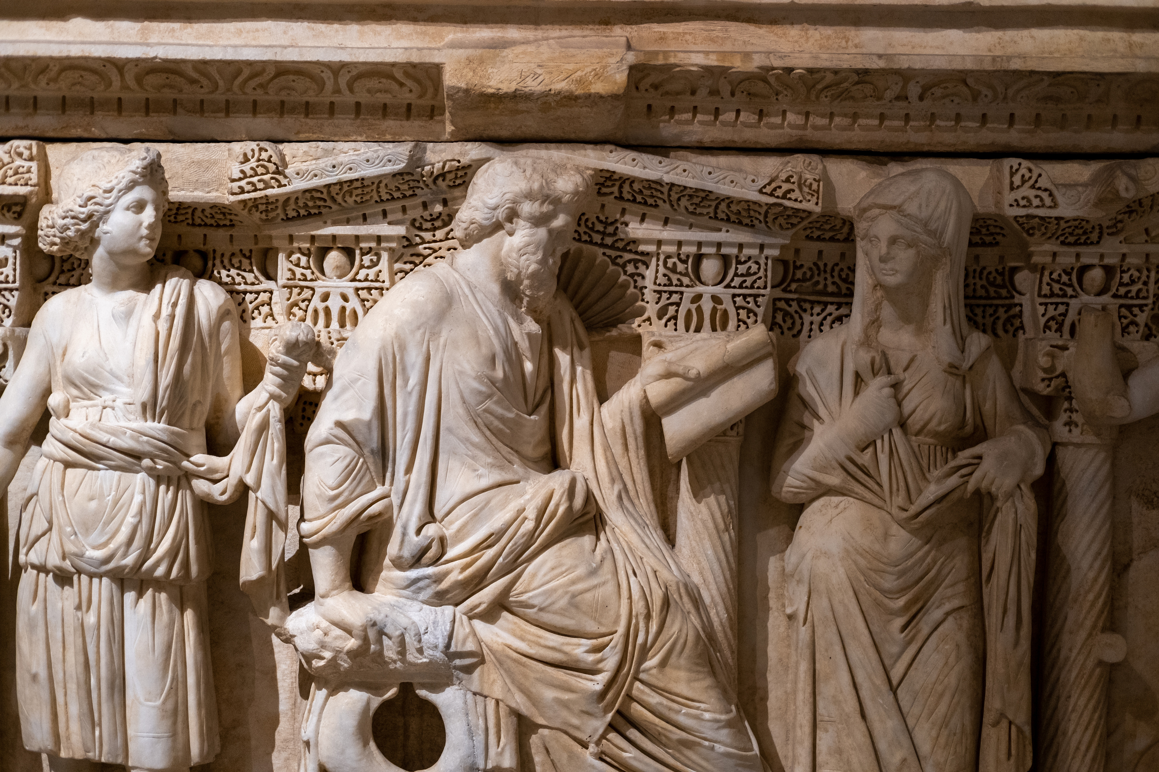
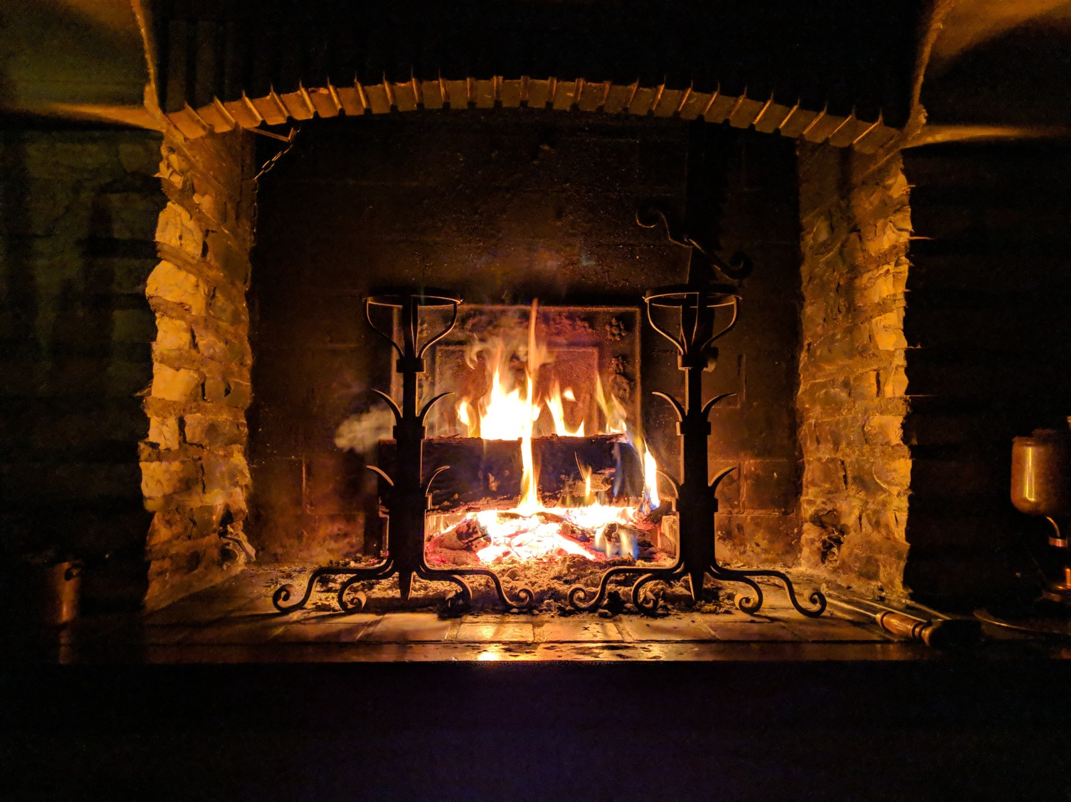
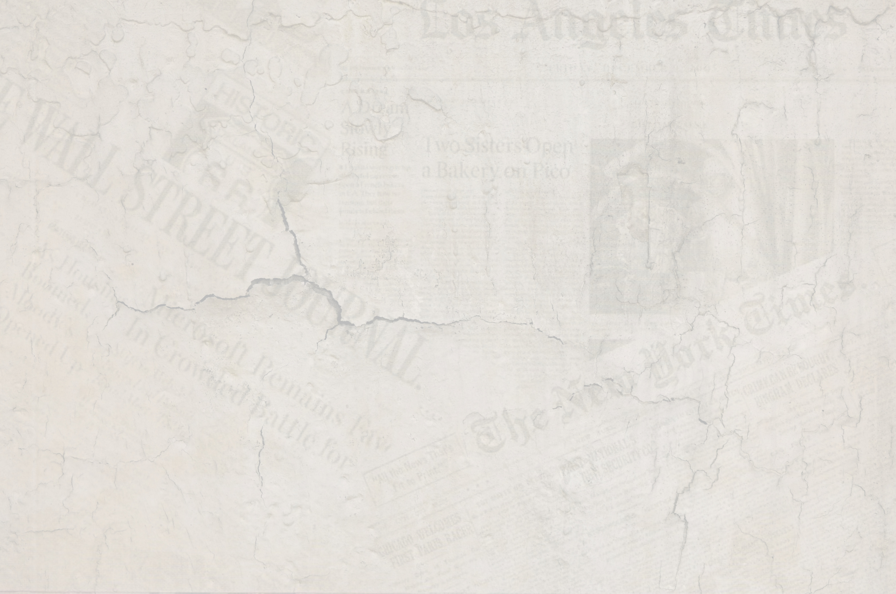
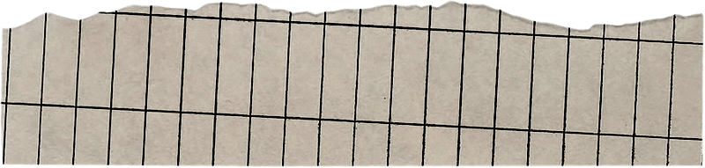
Chimneys
Notes:
12th century, invented chimney so they don’t keep doors open.

Slide 5
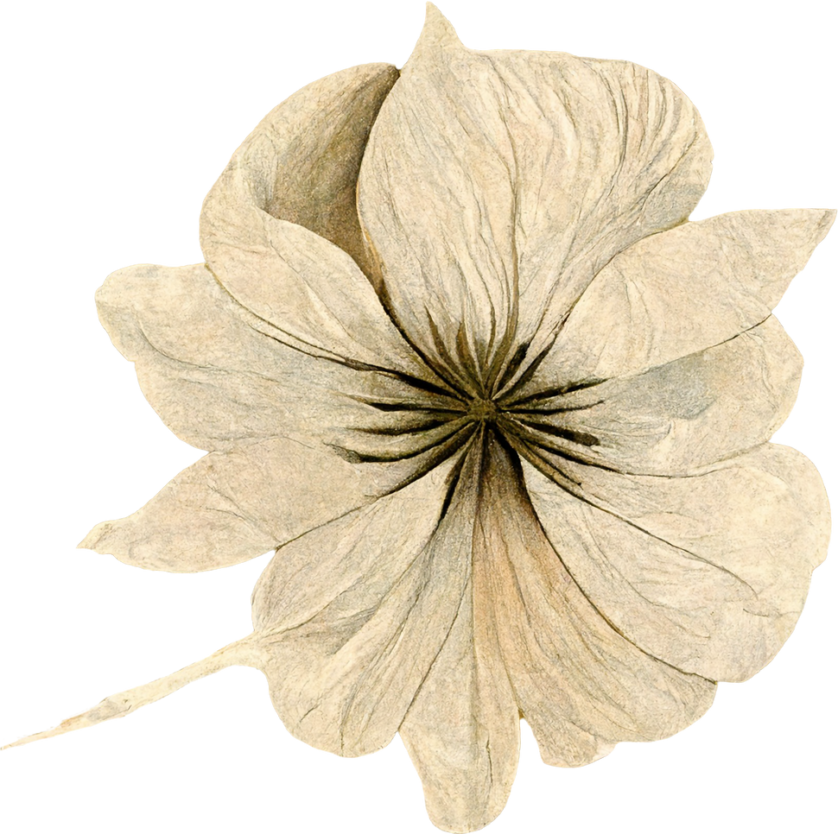
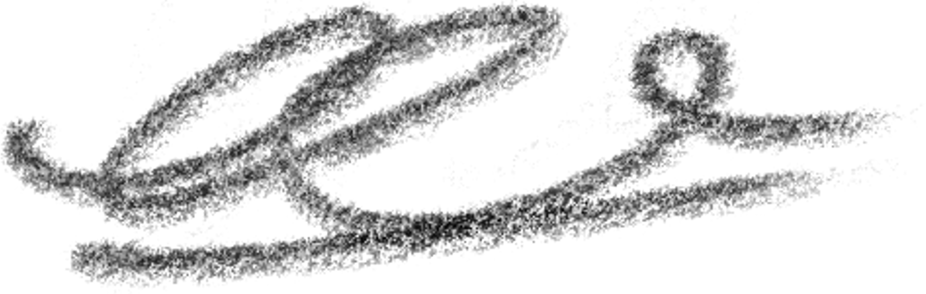
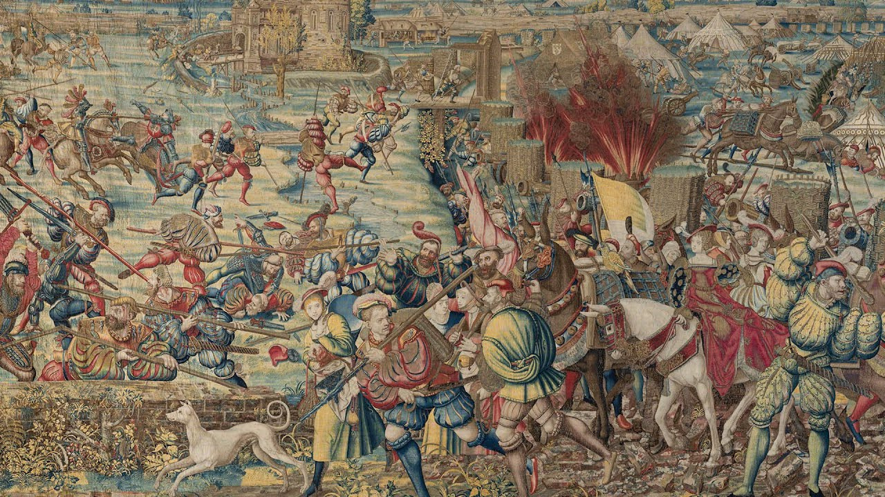
Tapestrys
Notes:
Painters, used to put up cloths on the walls to keep warm and keep out the draft which turned into rugs they placed everywhere to keep their bodies warm, then… Knitting and buttons on clothes

Slide 6

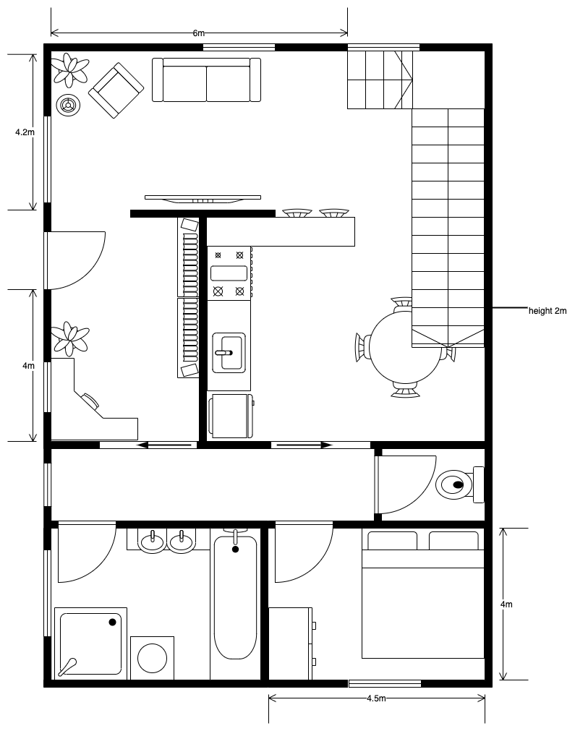

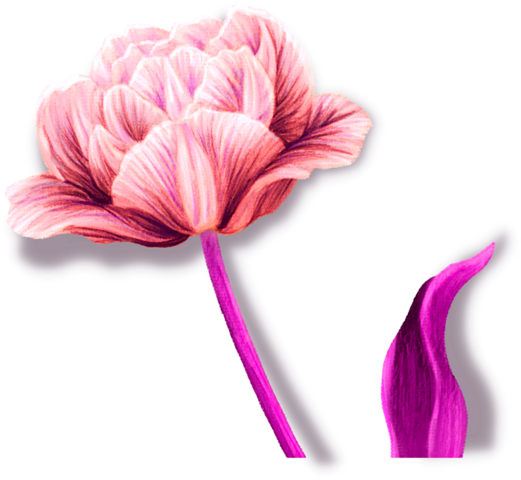
Privacy
Notes:
Because of fireplaces: Preoocupation of privacy started and so did cleanliness: Hot baths, hygiene began to effect table manners. No benches.

Slide 7
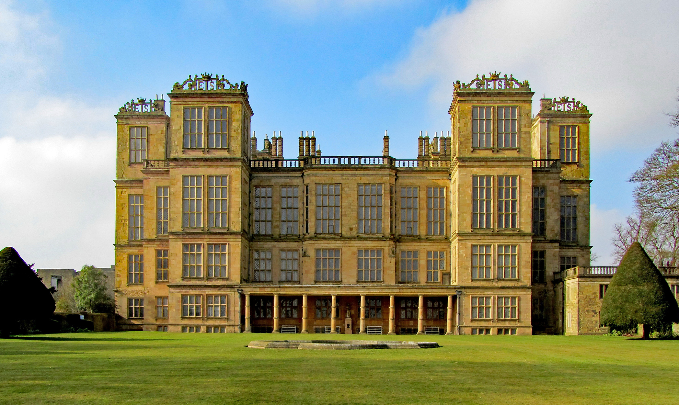
Hardwick Hall
Notes:
Hardwick hall, more glasses than wall.

Slide 8
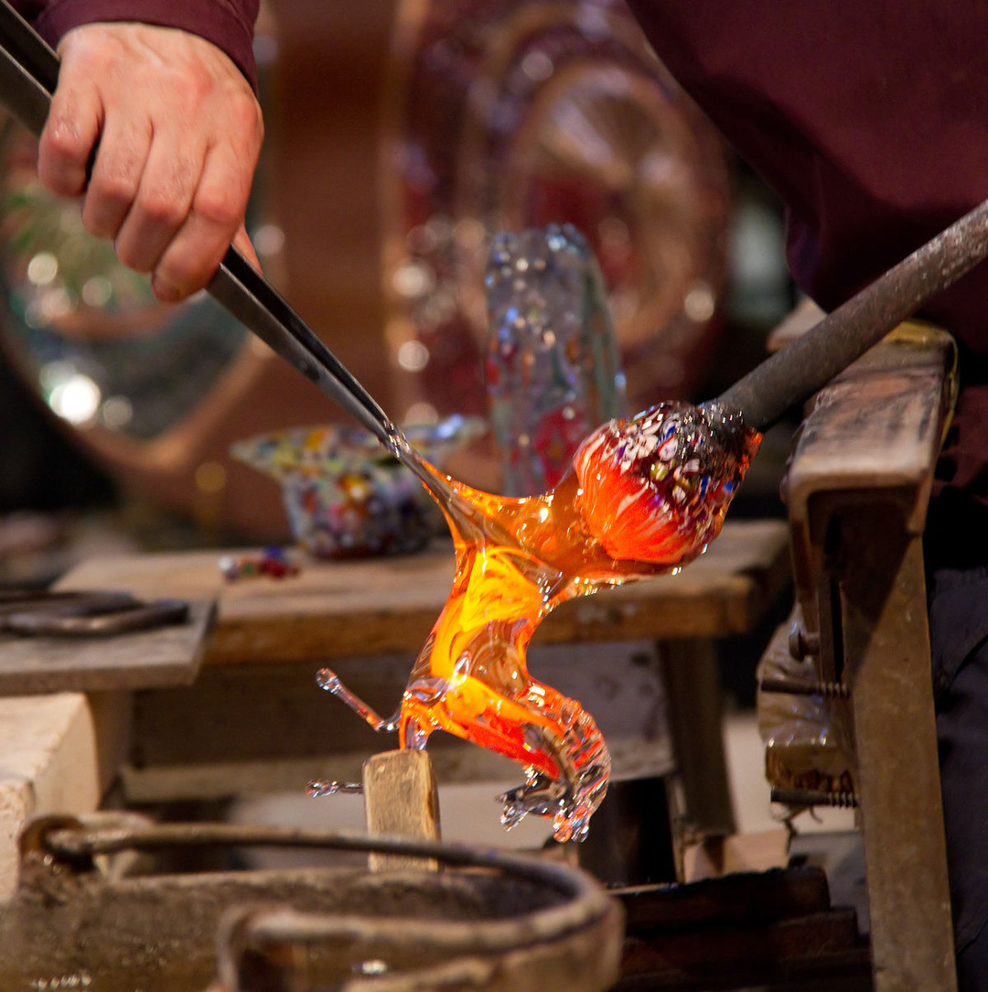
Glass Making
Notes:
People cutting down trees for furnaces to make glass. Zouch is like lets use coal instead of glass
Illegal to make glass with wood.

Slide 9
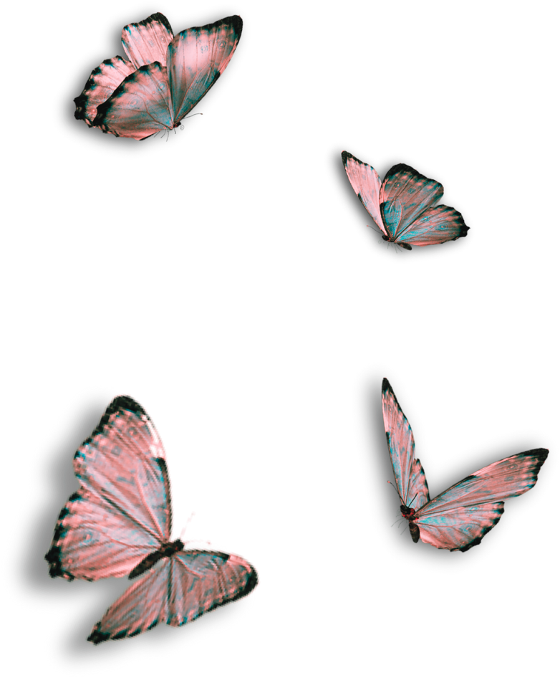
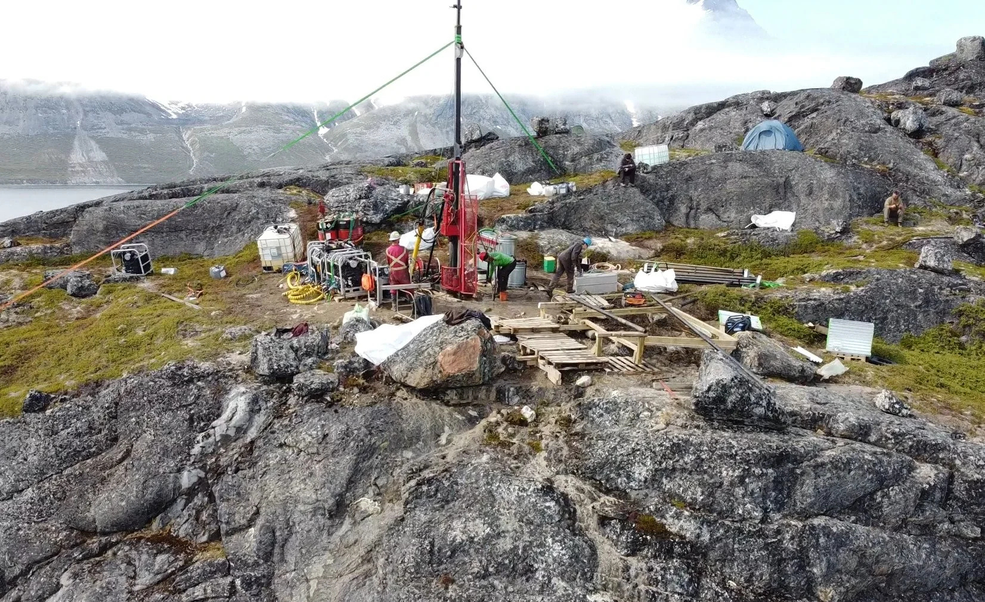
Mining
Notes:
With all of this mining activity, a problem was raised`; the mines were flooded.
Thomas Newcomen invented The Newcomen Engine

Slide 10
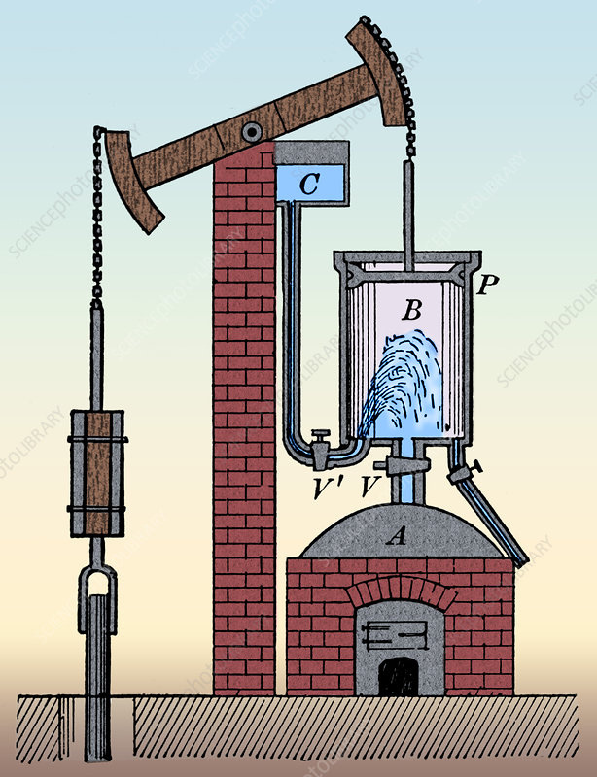
The Newcomen Engine
Notes:
Thomas Newcomen invented The Newcomen Engine to help with the flooding (Peep the fireplace at the bottom)
James Watt from Glasgow university was asked to fix a problem in one of the cylinders and he found out that its concept wasn’t very effecient and so he built something so precise that the cylinders were not up for the precision because it wasn’t a perfect cylinder.

Slide 11
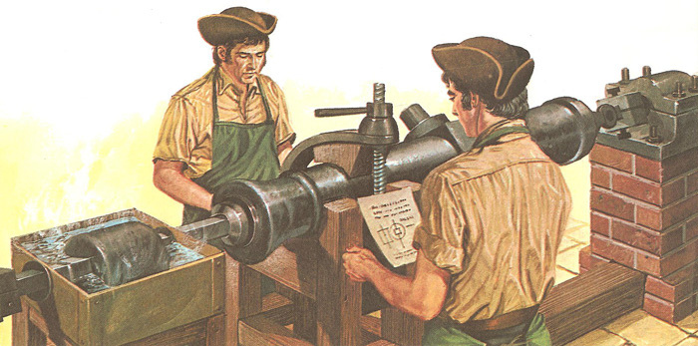
Canon Borer
Notes:
French people asked an ironmaker to fix a problem with one of their canons that use to spark out dust to which he invented something (A cannon borer to perfectly carve the cannon.

Slide 12
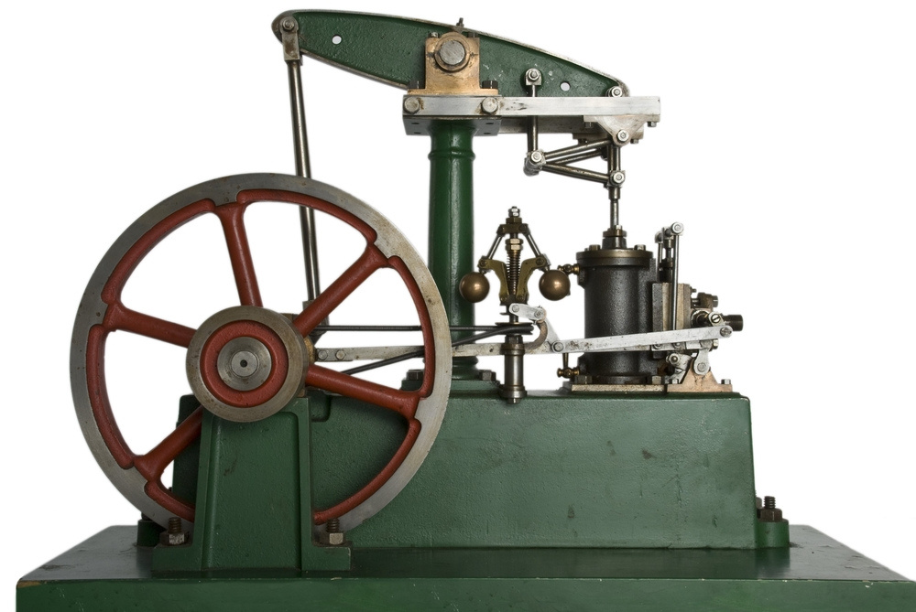
Steam Engine
Notes:
Thanks to John Wilkinson’s invention, steam power was to take people all over the world. Everyone bought their steam cylinders from him. His sister married someone who discovered Oxygen. He married her for her money. And he discovered carbonated drinks during a scientific sniffing.
By 1770, he was using gun barrels and heating up substances to make a small explosion of some sorts using the new electric sparks that were recently discovered.
He sent a letter to a man named Alessandro Volta. The letter arrived at Marshland which was perfect because it was surrounded by marsh.

Slide 13
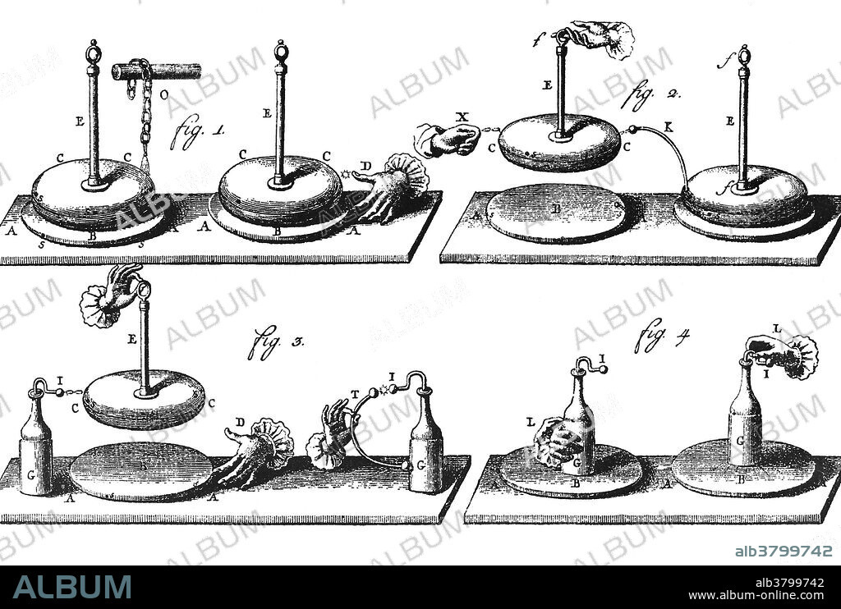
Volta’s Generator
Notes:
Alessandro Volta had invented a new way of making a spark, a kind of portable electricity generator. Identifying bad smells.
Volta went fishing and he was noticing some bubbles coming up from the march. So he approached it with the spark. He called it “Flammable air”

Slide 14
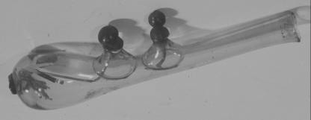

Volta’s pistol
Notes:
He used to carry his portable generator around for his next invention, the glass pistol. He wanted to turn it into a glass bomb weapon. The second function was that it’s perfect to find bad air.
At the time, everyone thought Malaria came from bad smelling air?
Of course, ppl eventually found out that it wasn’t and this is where this story almost ended but it didn’t.

Slide 15
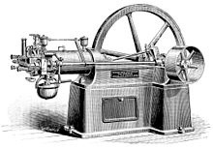
Otto Engines
Notes:
Gottlieb Daimler and Wilhem Maybach found another use of oil which is to produce Otto engines which were used

Slide 16
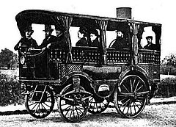
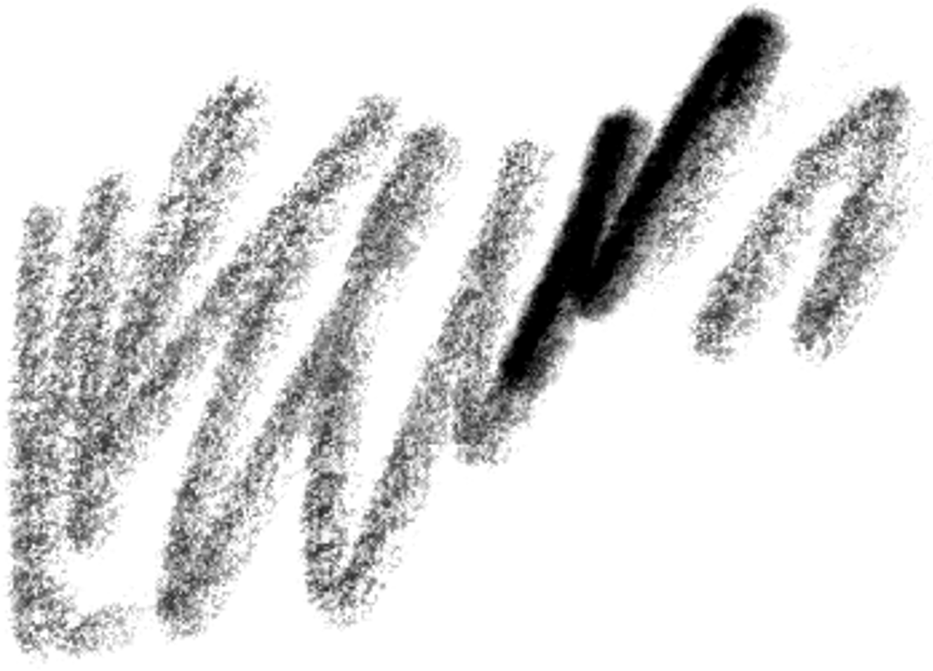
Carriages & Mercedes
Notes:
Somehow led to this. And Mercedes. where the this engine used the electric spark (Peep the Volta's glass gun reference) to ignite the engine

Slide 17
